Slide 1

Welcome To Year One
Notes:
Annie

Slide 2





Caterpillars
Mrs Terry Mrs Vass Mrs Ginn Mrs Z Mrs K
Notes:
Katherine/Emma

Slide 3
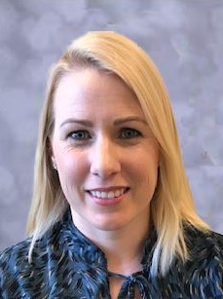

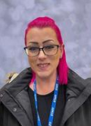
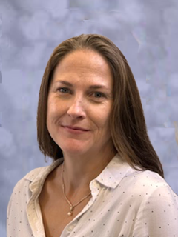
Centipedes
Mrs Dixon Mrs Bala Mrs D’cruz Mrs Moss
Notes:
Shelley

Slide 4
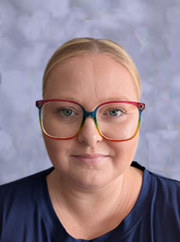
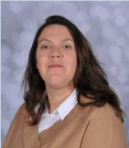

Fireflies
Miss Menzies Mrs Baron Mrs Parr
Notes:
Annie

Slide 5
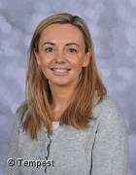
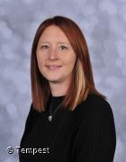


Inclusion Team and Office TEAM
Mrs Dean
Mrs Othen, Mrs Jaffries and Mrs Jackubait
Notes:
Emma/Katherine

Slide 6

Curriculum Intent
Notes:
Annie

Slide 7

School values
Notes:
Emma/Katherine

Slide 8

School values
Notes:
Emma/Katherine

Slide 9
Transition from Reception to Year one
Learning zones for core areas with enhanced activities and experiences to support the Year 1 Curriculum.
This structure will continue throughout Autumn Term in order for provision to match their prior experiences.
The Learning Zoo will continue and award the effective learning skills.
Notes:
Annie

Slide 10
Year DAILY TIMETABLE one
Register
Handwriting carousel
Phonics
English/ Discovery Learning
Assembly
Fruit Snack and Playtime
Reading
Maths/ Discovery Learning
Lunch and Playtime
Foundation Subject/ Discovery learning
Story and Fruit
Home
Notes:
Shelley

Slide 11

Things to remember
PE- 2 sessions a week on Monday and Wednesday. Children come dressed in kit appropriate for the weather. These sessions may change throughout the year due to extra-curricular activities with outside sports agencies.
Daily Fruit for Snack (school provides 1 piece a day)
Reading books will be changed on a Friday. Please send in your child’s reading record daily so we can mark when we have read with them.
If your child has milk – it will be given in the classroom during the day.
Notes:
Shelley

Slide 12


Rewards and Behaviour Management
Positive Reinforcement
Proud Cloud – Behaviour and Values
Learning Zoo Stickers
Marble Jar Treats
Weekly Star Learner
Sports star
Showing their learning to Mrs Bush
Notes:
Emma/Katherine

Slide 13
Phonics
We use Little Wandle to teach Phonics daily
There is a website available with a parent section that has videos, resources and materials to support your child’s blending and segmenting.
https://www.littlewandlelettersandsounds.org.uk/resources/for-parents/
Notes:
Annie

Slide 14
ENGLISH – end of year expectations
Correctly formed letters, finger spaces, capital letters and full stops
Use of adjectives
Building stamina for writing
Learning to read their writing and make changes where necessary.
Notes:
Annie

Slide 15
Reading
We have a reading carousel everyday with 5 activities for the children.
1 – Reading with the Teacher
2 – Reading with learning support assistant (LSA)
3 – Independent phonics activities
4 – Enjoyment for reading independently
5 – Comprehension activities
Notes:
Emma/Katherine

Slide 16
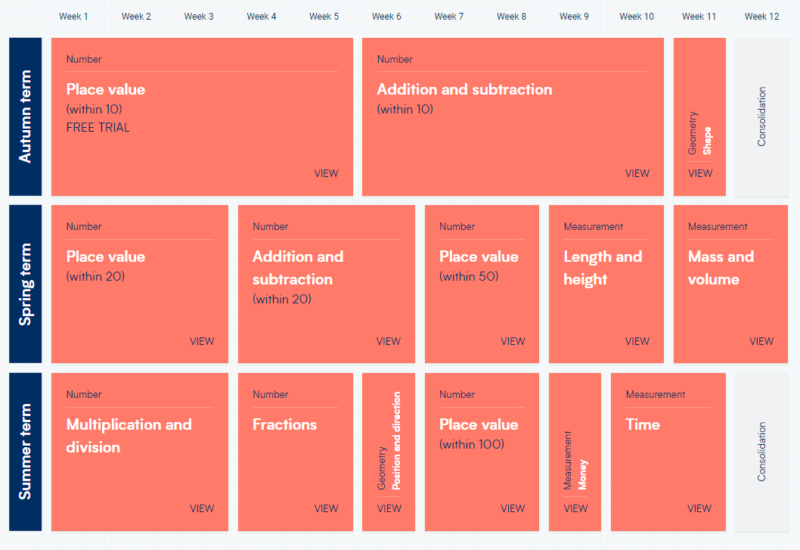
maths
We have created our own knowledge and skills and use it as a tool linked to the White Rose Maths scheme.
Notes:
Shelley

Slide 17
Handwriting
We have daily handwriting lessons to teach the children how to form their letters correctly.
Over the Summer holidays it would be extremely helpful if you could practise letter formations with your child in a fun and practical way!
https://home.oxfordowl.co.uk/english/primary-handwriting/handwriting-year-1-age-5-6/
Notes:
Annie
The children do NOT need to be able to join their handwriting by the end of Year One.

Slide 18

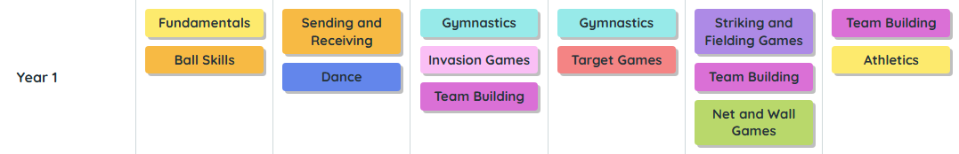
PE
We will be using Get set 4 PE.
Notes:
Shelley

Slide 19

Purple Mash
Purple Mash is a great online learning resource for children to reinforce learning.
Purple mash is a fantastic tool that we use in school and is available for you to use at home.
We teach e-safety to the children in an age appropriate way.
Notes:
Emma/Katherine

Slide 20
Assessment
Initially, the children will be assessed in their Writing, Reading and Maths to identify next steps and areas to develop with individual children.
In English, the children complete a piece of unaided writing once a half term, for teachers to assess against the National Curriculum objectives.
Reading Assessment – The main tool to assess the children’s reading will be through our Little Wandle Phonics programme. This will take place on a half termly basis.
In Maths, we complete fun problem solving questions on a half termly basis.
Notes:
Annie

Slide 21

Helping at home
We welcome your support with your child’s learning!!!
Daily Reading – this can be whilst cooking dinner or driving home
Maths – creative ways to introduce counting e.g cooking
Letter formation – practise in a variety of ways e.g sand, whiteboards, flour
Notes:
Emma/Katherine

Slide 22

Tapestry
Please keep an eye on Tapestry as we still use it in Year 1 and will update with ‘WOW’ learning moments. There will also be class posts for experiences and activities throughout the year.
If your child does any extra learning or has a wow moment that you want to share please add an observation and we like to use ‘Reflection Time’ at the end of a day to share as a class.
Notes:
Shelley

Slide 23
Parent helpers
We welcome Parent Helpers and would very much like to have you in school to support the children with a range of activities.
The training date for Parent Helpers will be released in September.
Please look out for these on the school Newsletter.
Notes:
Emma/Katherine

Slide 24

Communication
With an ‘open door’ policy, please feel free to see us at the start or end of day. We can also be contacted via our team email address;
year1@wbis.org.uk
Class teacher
Year group leader
Senior leadership team
Notes:
Shelley

Slide 25

Please check the school website regularly for updates!
SCHOOL WEBSITE
Our school website has a wealth of information and the Class Pages (Year 1) has resources and materials to support your children’s learning at home.
Notes:
Annie

