Slide 1




Welcome to Year Two
Notes:
Sophie

Slide 2
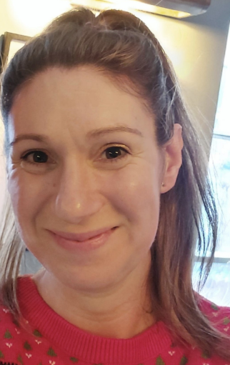
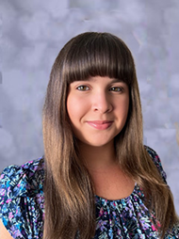
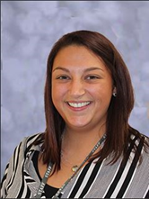
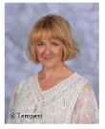
Who’s Who in Year Two…
Glow Worms
Mrs Mcluskey
Dragonflies
Miss Austwick
Ladybirds
Mrs Walker (Miss Pugh) – Year 2 Lead , DDSL, SLT
Mrs Geaves
Notes:
Ourselves

Slide 3
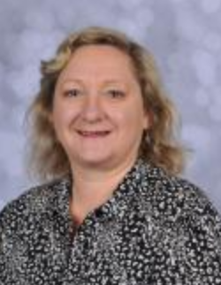
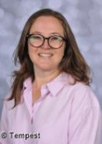
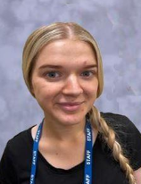
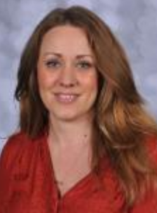

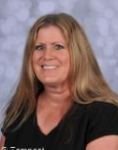
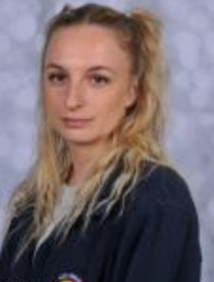
Who’s Who in Year Two…
Ladybirds ~ Mrs Pemble, Mrs Madden, Miss Gunner
Dragonflies ~ Mrs Rammel, Mrs Mitchell
Glow Worms ~Mrs Heywood, Mrs O’Connor
Notes:
Sophie

Slide 4
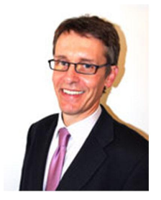
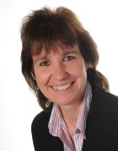
Governors
Peter Abbotts
Vice Chair of Governors
Angela Woods
Chair of Governors
To meet our other Governors please visit:
http://www.west-byfleet-infant.surrey.sch.uk/school/governors/
Notes:
Victoria

Slide 5
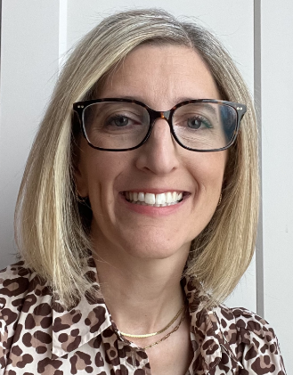
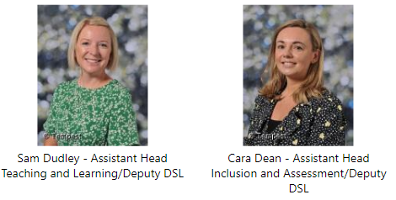



SLT
and Mrs
Mrs Bush
Head Teacher
Office Team
Notes:
Victoria

Slide 6
OUR VISION
We aspire for all children to feel a sense of BELONGING by providing a happy, safe and caring environment where children flourish academically, socially and emotionally.
Our child-centred and creative curriculum INSPIRES all children to take risks, ask questions and challenge their thinking.
Our belief is that all children will SUCCEED on their learning journey and we aim for all individuals to build the foundations of a life-long learner and always have high expectations to achieve.
Notes:
Sarah

Slide 7
Our Aims for Year Two…
Firstly, we want to ensure that children are happy, settled and confident in order for them to achieve their very best ☺
We aim to motivate the children to learn in a fun and caring environment where they feel secure and work hard to reach their potential.
We want all children to become life long learners and develop their independence.
Notes:
Sarah

Slide 8

Notes:
Amie

Slide 9
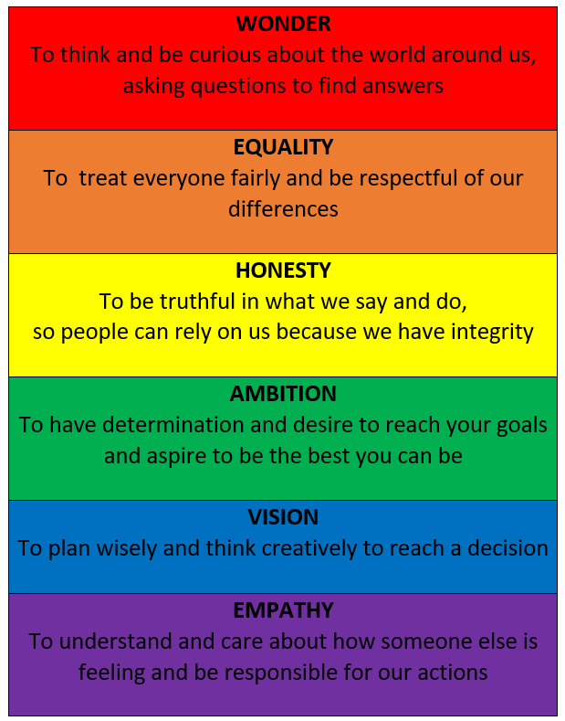
Notes:
Amie

Slide 10
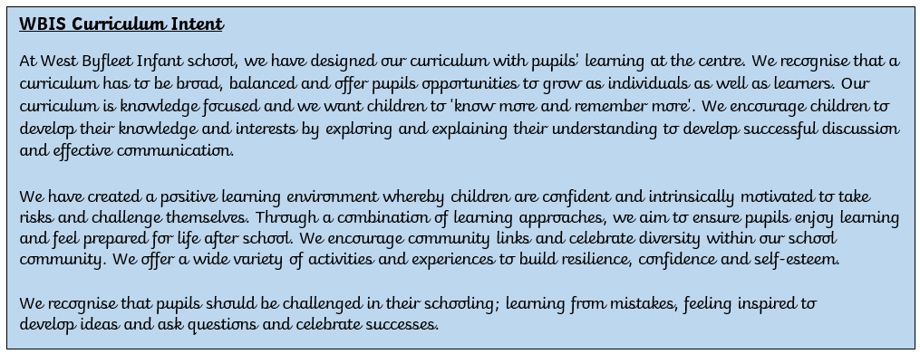
WBIS Curriculum Intent
Notes:
Sophie

Slide 11
The day in Year Two…
Morning Activity
Phonics
English
Assembly and playtime
Maths
Lunch
Science/Foundation subjects
Guided Reading
Story, Fruit & Home
Notes:
Sophie

Slide 12

Things to remember in a typical week…
Friday - Books will be changed once a week
Tuesday and Friday – Please send your child dressed to school in their PE kit (suitable for all weathers)
Tuesday - outdoor kit
Friday- gymnastics kit –we remove shoes and socks so no tights
Notes:
Victoria

Slide 13
English
We use high quality texts to support the teaching of English.
We have a two week writing cycle where the children go through a journey of exploration, planning, rehearsal, writing and editing.
Our aim is to make writing as fun and exciting as possible for the children and involve drama, debates and covering all genres of English.
Notes:
Victoria

Slide 14

Reading
Read easily, fluently and with good expression
Demonstrate a high level of comprehension, understanding what they have read and refer back to the text
To use inferential skills to show understanding
Develop the habit of reading widely and often, for both pleasure and information
Acquire a wide vocabulary and understand what words mean
Notes:
Sarah

Slide 15
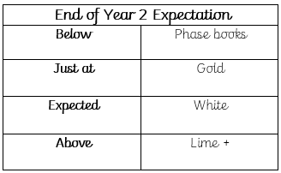
Reading aims for the end of year 2
By the end of Year 2 the ‘Expected Standard’ / On track readers will be reading White band confidently.
In order to help your child’s reading progress, please see the ‘How to help your child at home’ in their Reading Record books.
Please see below for the breakdown of the reading bands in order to see the progression your child will make within phases / colour bands:
Notes:
Sarah

Slide 16

Handwriting…
It is vital the children are able to form all letters clearly and in the correct orientation.
Without this they will not be able to join their writing successfully and build the stamina needed for the end of year expectation.
We teach handwriting explicitly in class.
We award a ‘pen licence’ when the children are ready!
Notes:
Amie

Slide 17
Spellings
Spellings will be tested in the form of a dictation every two weeks. Spellings will be on the website page.
The children will also get a chance to practise these during our guided reading time.
Spelling groups are linked to end of Year 1 phonics assessments - we will inform you via a label on the front of your child’s home learning book.
Notes:
Sophie

Slide 18
MATHS
Within each Maths lesson, we allow for practice with fluency, problem solving and reasoning.
By the end of Year 2, the children are expected to explain their reasoning in written form.
We still use the Concrete Pictorial Abstract (CPA) approach in Maths and this is vital for children to have a concrete understanding of their learning.
We will share new methods via the web page as and when needed.
Notes:
Sophie

Slide 19
Assessment language
Your children will be assessed using criteria that links to the end of key stage 1 framework (combination of Year 1 and Year 2 Curriculum).
The assessment language we use at West Byfleet Infant School:
Below
Just Below
Just At
Expected (working at the end of year expectation)
Above
Notes:
Victoria

Slide 20


Home learning…
You are vital to your child’s learning ☺
Daily reading & discussing the text to support understanding
Sharing stories / encouraging audiobooks at home to develop imagination
Home learning will be on our website year group page. Included will be a grid with 6 activities for your child to complete. These will be a mixture of written / creative / verbal / project based learning outcomes. To support your child, providing guidance and showing how to make improvements by highlighting up to 3 edits is suggested.
Home learning is not compulsory for KS1 children.
Notes:
Victoria

Slide 21

E-Safety
We teach E-safety to the children in an age appropriate way.
Please be aware that children are able to access a lot of content very easily.
Please put restrictions on your phones, laptops, iPads so it is not as easy for them to gain access to inappropriate content, sometimes without meaning to.
We advise you to follow government guidance and limit the time your child has access to a device each day.
Notes:
Sarah

Slide 22

Notes:
Sarah

Slide 23
Communication Trail
Please make sure that you use the communication trail to ensure that the right people can help you.
Class Teacher – this can be done via pick up / drop off or using the year2@wbis.org.uk email address
Year Leader- Mrs Sophie Walker
Assistant Head - Inclusion - Miss Cara Dean
Assistant Head - Teaching and Learning - Mrs Dudley
Headteacher - Assessment - Mrs Bush
Notes:
Sophie

Slide 24
Thank You for LISTENING!
year2@wbis.org.uk
Notes:
ALL!

